Slide 1
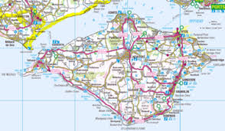
Isle of Wight Initial Information

Slide 2
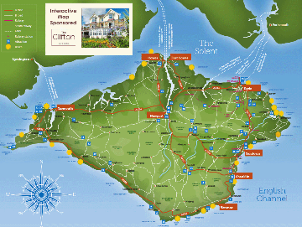
Why Isle of Wight?
Why go to the Isle of Wight?
To support and enrich the work we do in school and develop learning beyond the classroom
To encourage children to work together, developing both confidence and resilience away from home
To enhance children’s self-esteem
To have fun!

Slide 3
When is the proposed visit?
Monday 18th May – Friday 22nd May 2026
(The week after SATs)

Slide 4
Visit Overview
Due to the size of the group, the visit will be organised largely as two separate groups, staying in two different hotels.
The two groups will visit the same places but on different days.
Mrs Robinson leads one group; another member of the Year 6 team will lead the other.

Slide 5
Organisation of the visit
The overall organisation of the visit will be undertaken by Activity Island Limited.
A very experienced company who specialise in booking visits of this nature, solely in the Isle of Wight.
I have worked with them for many years.

Slide 6
Activity Island Limited
Services include:
Coach transport
Ferry transport
Good hotels
Services of staff who organise every aspect of the visit for us
Written risk assessments
Provision of teaching materials and pupil packs
Two-day familiarisation visit for 4 staff members
Services of an Island Representative throughout the visit

Slide 7
Travel Arrangements
  We will be travelling in 2 two-decker luxury coaches which will stay with the children throughout the visit.
  We cross The Solent from Portsmouth arriving at Fishbourne

Slide 8
Hotels
  We have provisionally booked two hotels, both in Sandown.
  The hotels have been chosen for their suitability for school parties and provide a ‘home from home’ atmosphere.
  Full board accommodation is provided (including packed lunches) commencing with the evening meal on Monday 18th May.
  Special diets can be accommodated.
  We are the only hotel residents during the visits so the hotels are very secure and safe.

Slide 9
Hotels
  Sandhill Hotel
  This hotel is very familiar to us as we have used it for the past five years.
  Channel View Hotel
  This is a much larger hotel, with smaller grouped rooms. This will be our fourth visit here.
  Please note that there are very few hotels that can accommodate groups as large as our school. Historically, we have managed to have two classes in each hotel; however, the visit is becoming more popular each year so we may have to split the classes up slightly as Sandhill Hotel can only accommodate 56 children whereas Channel View can accommodate far more.

Slide 10
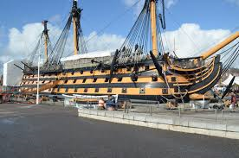
Visits – Something for everyone!!
HMS Victory – Portsmouth
Vice-Admiral Nelson’s Flagship
Children see the cabins of Captain Hardy and Vice Admiral Nelson, the gun decks and the cockpit where Nelson himself passed away, as well as finding out about many aspects of Naval life in the 1800s.

Slide 11
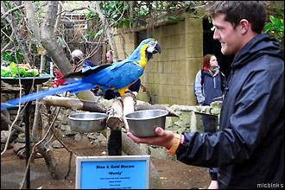
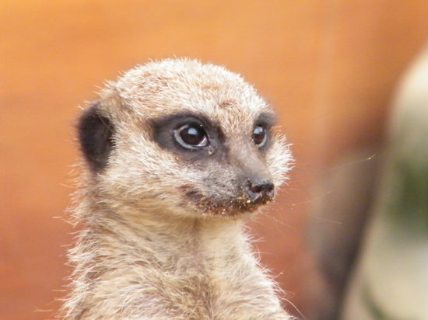
Visits
Amazon World
Over 200 different species of rare and exotic mammals, birds, reptiles, insects and fish, all set in their natural jungle environment.

Slide 12
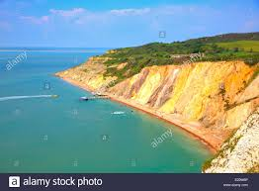
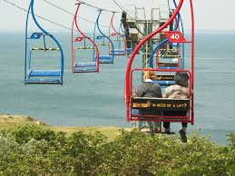
Visits
Alum Bay Glass, Needles Chairlift
and Needles Pleasure Cruise
Set on the famous coloured sand cliffs of Alum Bay.
Children can watch glass being blown into decorative and functional items. The Pleasure Cruise passes the remains of the original Needles Rock as well as passing close to the light house. The chairlift is always a highlight of this visit.

Slide 13
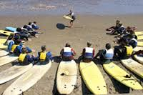
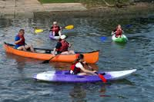
Visits
Sea Sports
Open-canoeing, kayaking, surfing and for those children who are a little ‘unsure’ skimming and body boarding very close to the beach. Fully qualified instructors. All safety and necessary equipment, including wet suits and life jackets, supplied. Safety boat on the water at all times. All activities take place within 50 yards of the water’s edge.

Slide 14
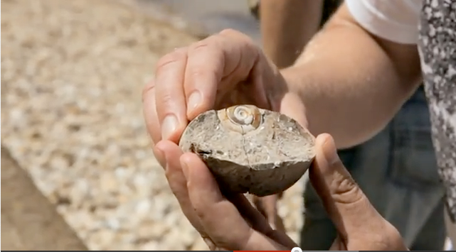
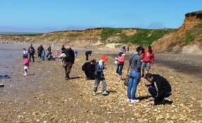
Visits
Fossil Hunt
An inspiring twenty minute talk followed by a beach visit with a guide and the chance to collect fossils and other interesting objects from the abundance available. One of the most popular activities on the island!

Slide 15
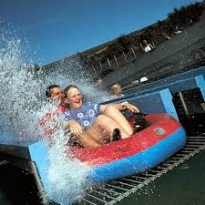
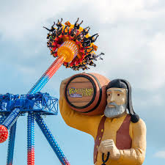
Visits
Blackgang Chine
The Isle of Wight’s very own theme park which includes:
Giant Maze, Water Gardens, Frontier Land, Rumpus Mansion, Triassic Club, Smugglers Cave, Pirate Ship, Dinosaur Land, Funny Mirrors, Moonbase Games Station, Crooked House, Jungle Land and Water Splash Whale, to mention but a few!

Slide 16
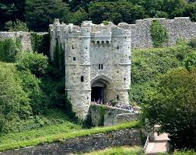
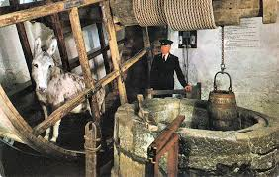
Visits
Carisbrooke Castle
Carisbrooke Castle is a complex site with walls dating from the early 12th Century. The castle was Charles I’s prison for over a year and is also famous for its well and donkey-operated treadmill.

Slide 17
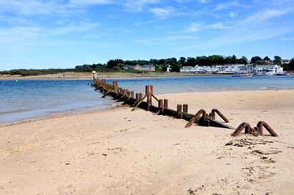
Evening Entertainment
Beach walk and games
Magic Show
Theatre Show (at the theatre)
Party Night

Slide 18
Activities
Both groups will visit the same places, but on different days.
A sample itinerary is attached as a separate document.

Slide 19
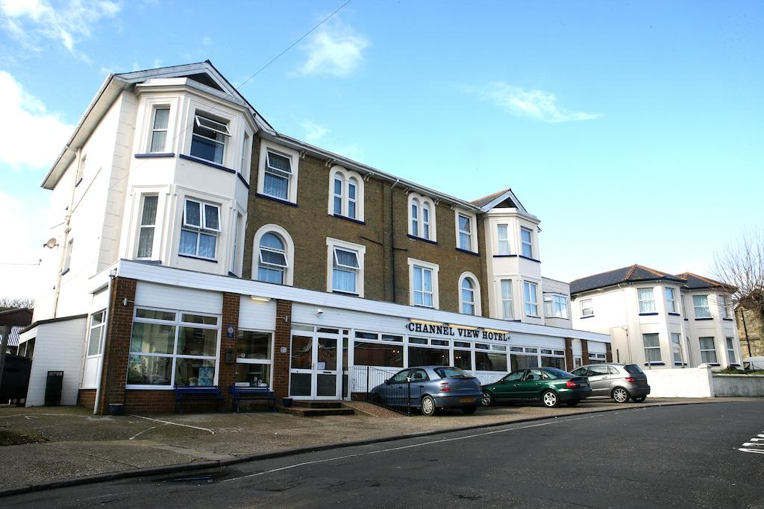
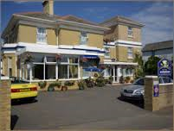
Hotels
Channel View Hotel
Sandhill Hotel

Slide 20
Comments from parents -
I wanted say a big “Thank you” for making the residential such a wonderful week for my daughter. She’s had the absolute time of her life and I know it will be something she’ll always cherish.
I’d just like to say a big thank you and well done to you from my son and myself. Thank you for keeping him safe and for the wonderful time that you have allowed him and all the children at Buttsbury junior school to experience.
My daughter had the best time and said she missed her friends last night! Thank you so much to all the adults who make it possible, I think she is now ready for her next adventure of secondary school.
The information meeting, organisation and enthusiasm you provided for the trip supported our daughter to overcome many personal hurdles and we are very grateful.
Thank you to you and your staff for a great week. Our son is raving about Amazon World, the magician, fossil hunting and the ferry.

Slide 21
Insurance
The visit will be fully insured by our school insurer’s RPA.
The visit cost will be approximately £548 (£31 increase since last year)

Slide 22
Questions
Please email questions to:
head@buttsburyprimary.essex.sch.uk
Or call the School Office to speak to Mrs Robinson

Slide 23
France
06:15 (English time) | Children arrive at Buttsbury and board coaches straight away – please make sure children have been to the toilet before leaving home. They do not go into class.
06:30 (English time) | Coaches depart
09:00 (English time) | Train (Toilet visit and snack at terminal)
10:20 (English time) | Channel Tunnel
11:55 (French Time) | Arrive at France – go to Cite-Europe
14.00 (French time) | Leave Cite-Europe
14:15 (French time) | Arrive at Bleriot Beach – Calais – for lunch, paddling and beach games
16:00 (French time) | Leave for terminal
16.20 (French time) Train – 17:20 (French time) | Arrive at terminal (Toilet visit)
19:00/19:30 (English time) | Arrive at Buttsbury

Slide 24
Details for France
There are three coaches –
Coach 1 – 5B plus some children from 5R – Mrs Robinson, Miss Burt and Miss Hall
Coach 2 - 5P plus some children from 5R – Mrs Cattini and Miss Parrett
Coach 3 – 5T plus some children from 5R – Miss Roe and Mr Tweedie
If your child is in 5R, they will be informed, in advance, of their coach number.
We will be posting photos on X (formerly Twitter)

Slide 25
Further details -
Your child will need to wear school uniform but they may wear trainers instead of school shoes if they prefer.
They need to bring a packed lunch (as usual, no fizzy drinks or glass bottles please) and a packed tea.
They need to bring 2 filled water bottles, 2 healthy snacks. They will require some spending money in Euros which will need to be in a named purse/wallet as it will be the children’s responsibility to look after this. We recommend your child brings a maximum of €10 – small change is preferable.
They also need a clip board and a pencil/pen
Please also bring a towel (for after paddling) and sun cream

Slide 26
Further details -
We will take asthma pumps and epi pens from school – if your child requires a travel sickness tablet before the return journey, please hand the tablet into the School Office before Friday 20th June and complete a medication form at the same time.
Please don’t put a tracker on your child or their bag
All children require a passport – we will be collecting them in on the playground after school on Monday 23rd June. If you are unable to hand your child’s passport in then, please feel free to hand it into the School Office during the day on 23rd June or – if you trust your child – they can bring it to school themselves.
When we return to school, children will be signed out from areas on the playground – we will put the children’s passports back in their bags on the final leg of the journey.
.

