Slide 1
TimeS table

Slide 2
Why do children need to learn their times tables?
As well as being critical for everyday life, knowledge of multiplication tables helps children to solve problems quickly and flexibly, and allows them to tackle more complex mathematics later on in school.
Year 4 - Times Table Test
    June 2020
    Approximately 5 min
    Online
Increase in multiplication and division word problems in KS2 SATs.

Slide 3
Times Table Expectations
By the end of Yr 2 children are expected to know x2, x5 and x10 tables
By the end of Yr 4 children are expected to know all the times tables to 12x12.
Children should be able to recall both x and ÷ facts rapidly

Slide 4
Introducing the times tables
Count in multiples forwards and backwards
    e.g. 10, 20, 30 … 36, 33, 30, 27…
Chant times tables
    E.g. 1 times 6 is 6, 2 times 6 is 12 …
Encourage children to say them aloud

Slide 5
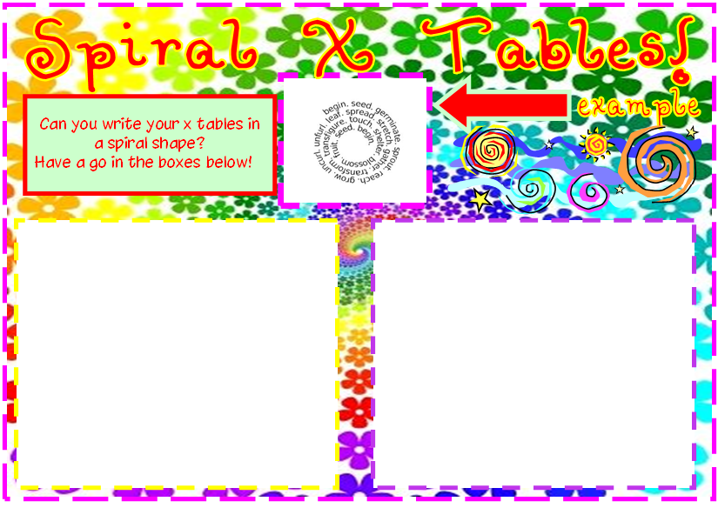

Slide 6
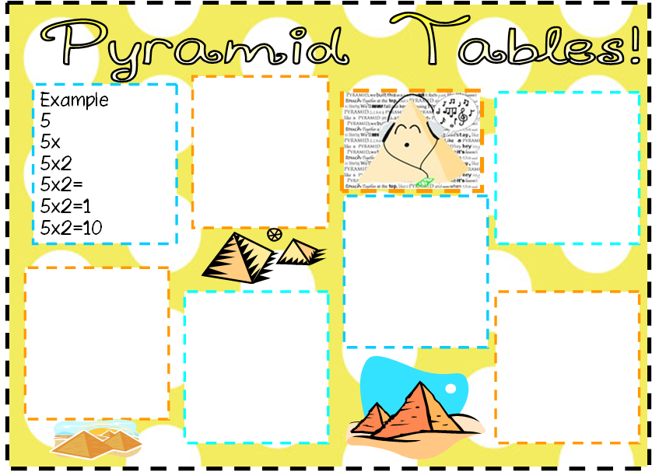

Slide 7
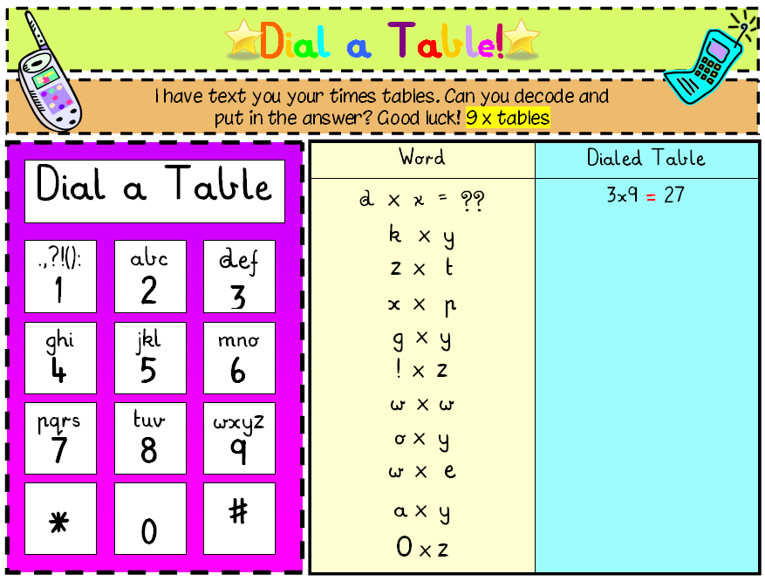

Slide 8
Practising…
Like any skill if times tables are not used regularly they can get forgotten.
When your child has mastered a times table it is important to keep practising.

Slide 9
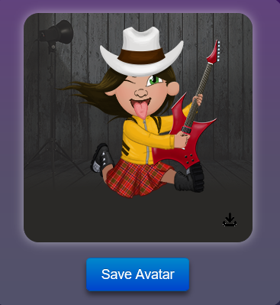
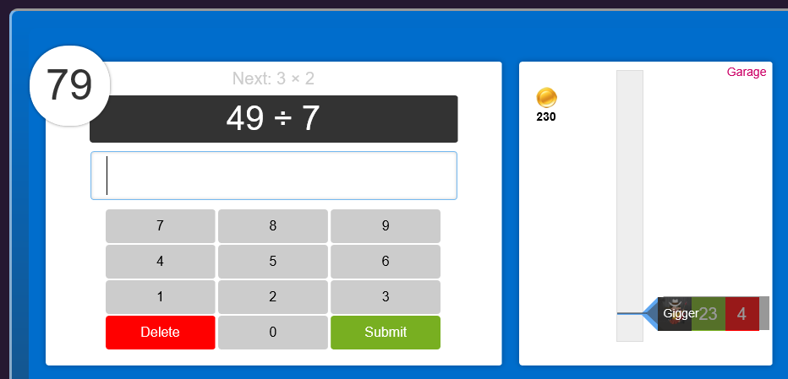
Times Table Rock Stars
https://ttrockstars.com/login
Use on computer or Ipad
Each child will have a log-in
Pick a Rock Star name and avatar
Practise recalling facts in given time
Practise time tables set
Practise 12 x12
Compete against others in the set
Gives you an average time for
correct answers

Slide 10
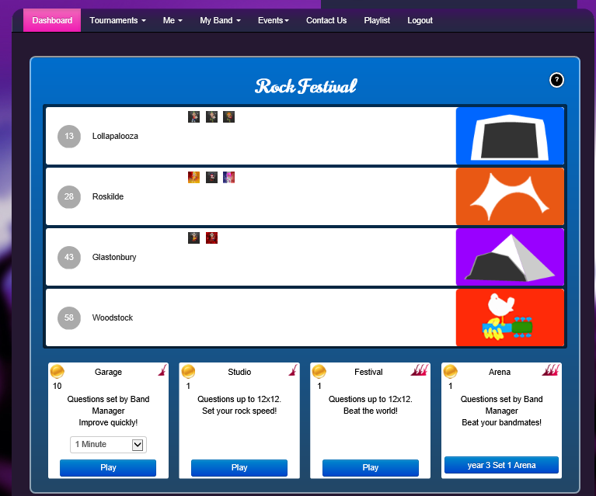
Under ‘Dashboard’ children can select ways to practise
Practise recalling facts in given time
Practise time tables set
Practise 12 x12
Compete against others in the set
Gives you an average time for correct answers

Slide 11
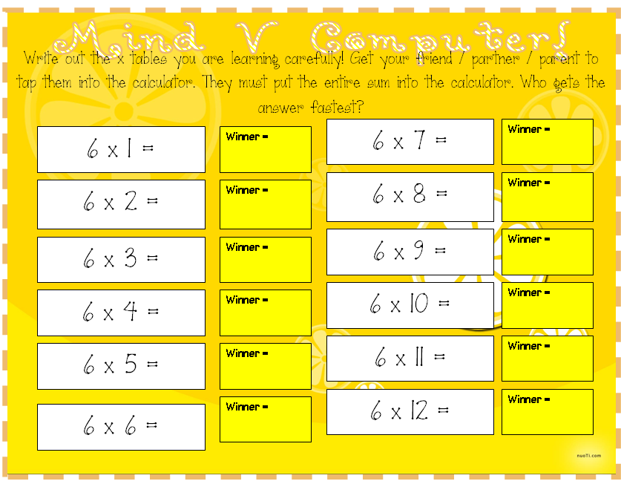

Slide 12
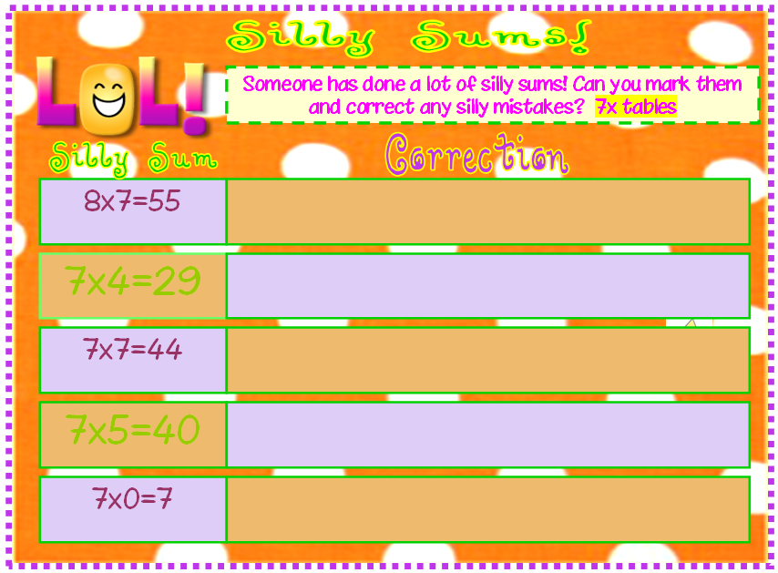

Slide 13
Helpful Times Table links
https://ttrockstars.com/home
https://www.topmarks.co.uk/maths-games/7-11-years/multiplication-and-division
http://primaryhomeworkhelp.co.uk/maths/timestable/interactive.htm
http://www.bbc.co.uk/skillswise/game/ma13tabl-game-tables-grid-find
https://www.timestables.co.uk/
https://www.mathsonline.com.au/games/times_tables
Apps:
Times Table Mountain App
Squeebles Times Tables
10 Minutes a Day Times Tables
Maths Rockx
Times Table Rock Stars
Hit the Button Maths
TimesX Multiplication Tester

