Slide 1

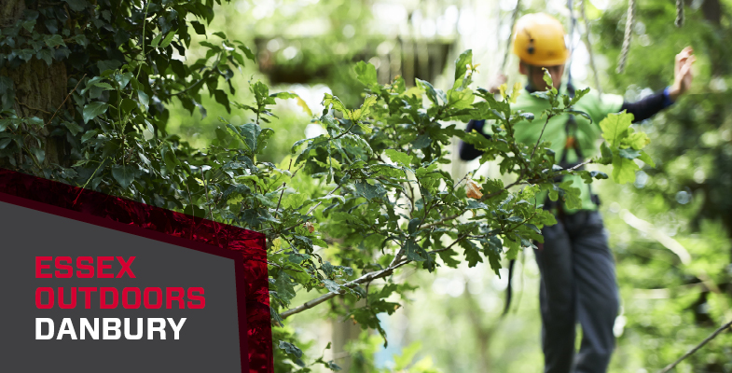
Danbury
18th -19th March 2027

Slide 2
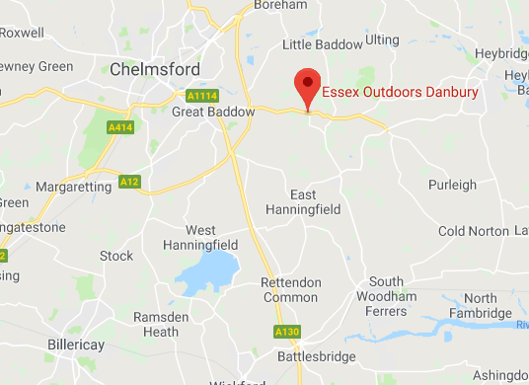
Danbury
Danbury is one of the centres run by Essex Outdoors.

Slide 3
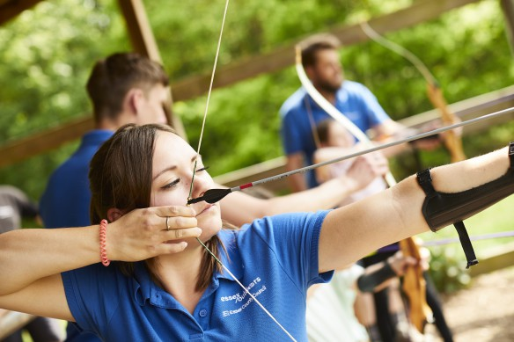
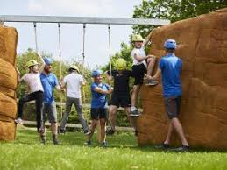
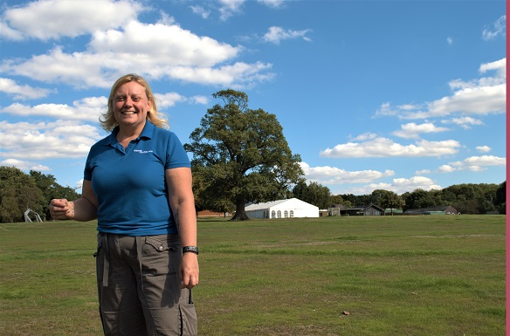
Aim of the trip:
By going on the trip, children are pushed socially, physically and mentally. We encourage the children to mix with children from other classes within our school.
At all activities, no child is ever forced to take part although Danbury staff and instructors support and encourage the children to take part as much as possible.

Slide 4
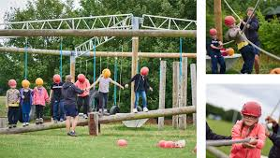
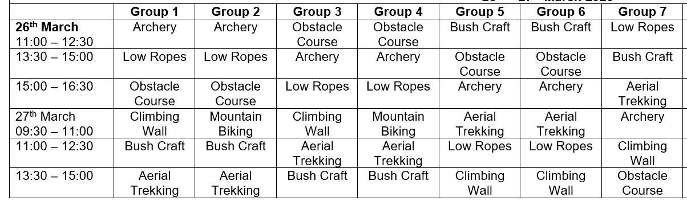
Activities
Children will take part in a range of outdoor adventure activities. Here is an example from a previous year’s itinerary:

Slide 5
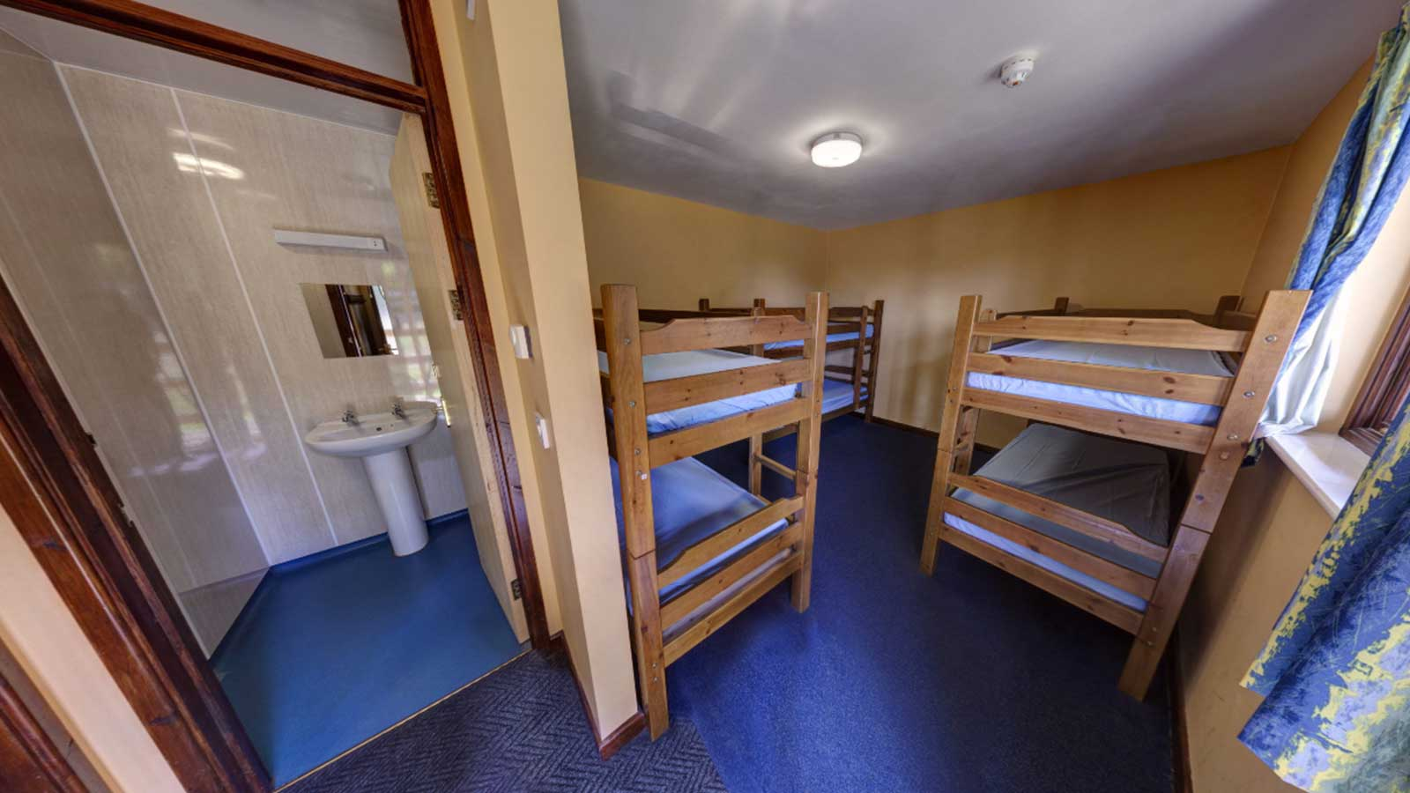
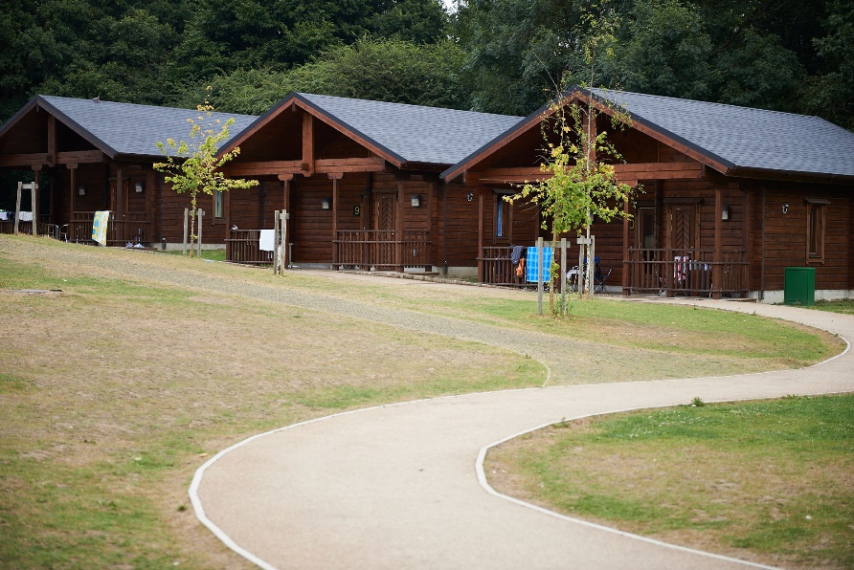
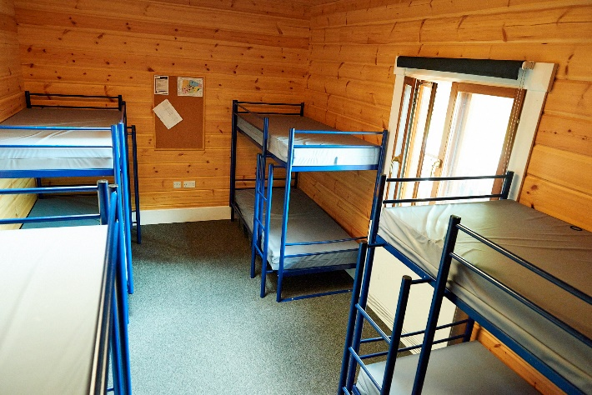
Accommodation
There are 2 types of accommodation at Danbury.
The lodges which sleep 8-10 with a separate adult room attached and a shared bathroom.
The wooden pods, which are next to each other, sleep 6-10 and have 2 separate adult pods. The toilet block is located nearby and children are escorted to the toilets by an adult.

Slide 6

Food
The children will be provided with dinner on the Thursday night, a cooked breakfast in the morning and lunch before we leave.
Danbury will cater for all allergies. Sauces and dressings are kept separate so that children can choose if they want to have these.

Slide 7
Site Security
Danbury site is surrounded by a fence and gate which is locked overnight.
Security lighting and CCTV are in operation in key areas.
A member of staff will be on duty overnight to assist with any problems.
All staff are DBS checked and wear a clearly recognisable uniform.

Slide 8
Insurance
The visit will be fully insured by our school insurer’s RPA.

Slide 9
Danbury
18th -19th March 2027
Cost: £171.55

Slide 10
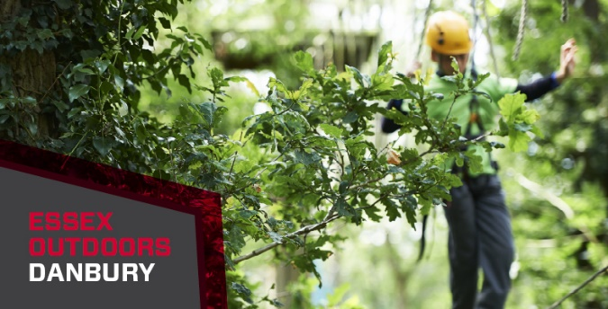
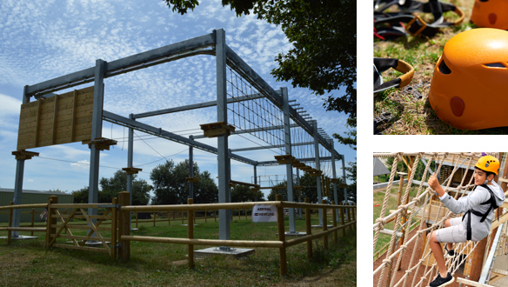

Questions
If you have any questions please feel free to contact me.

